Slide 1


TCP HyStart Performance over a Satellite Network
Benjamin Peters, Pinhan Zhao, Jae Chung, Mark Claypool
Notes:
Good Afternoon, my name is Ben Peters, I’m an undergraduate at Worcester Polytechnic Institute. This spring and summer I have been working with my fellow undergrad Pinhan Zhao under the advisement of Professor Mark Claypool and Jae Chung from ViaSat. We have been looking at TCP performance over Satellite Networks, especially the impact of HyStart on startup performance.

Slide 2


Satellites Coverage is Everywhere
Satellites provide global networking
  Remote locations
  On airplanes
  During emergencies
  Increased bandwidth (up to 150 Mb/s)
High latency (~300ms one-way)
300 ms
Notes:
Satellites provide accessible networking for all types of situations where traditional wired networking isn’t available such as remote locations, on airplanes, and during emergencies. Developments in satellite technology has increased the available bandwidth by about 20 times in recent years. However, due to the physics involved one-way trip times of about 300ms meaning minimum round-trip times are around 600ms. This makes modern satellite networks high bandwidth, high delay networks, instead of low bandwidth high delay networks.

Slide 3
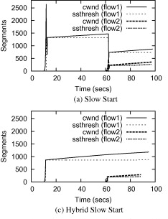
Performance Issues Over Satellites
Sender and receiver buffer sizes can affect performance
HyStart can exit slow start before loss to avoid overshooting
HyStart may exit slow start prematurely
Performance Enhancing Proxies (PEPs) are becoming increasingly ineffective
  VPNs
  QUIC
Few published studies over actual satellite networks
  Most use simulation or emulation
Notes:
We discovered two different causes for performance degradation, the first cause we discovered was sender and receiver buffer sizes being too small to allow for full link utilization. The second issue we discovered was that HyStart which is designed to exit slow start before loss to avoid overshooting the link throughput, which would cause high loss, would exit slow start extremely prematurely causing startup performance to drastically decrease. Increasing use of VPNs and fully encrypted protocols like QUIC mean that performance enhancing proxies and TCP proxies are not able to intercept traffic to improve performance across these links making it more important to improve performance without these proxies. There are also few studies the look at performance over actual satellite connections with most using simulation or emulation.

Slide 4
Outline
Introduction (Done)
Background (Done)
Methodology (Up Next)
Buffer Settings Results
Hystart Results
Conclusion

Slide 5
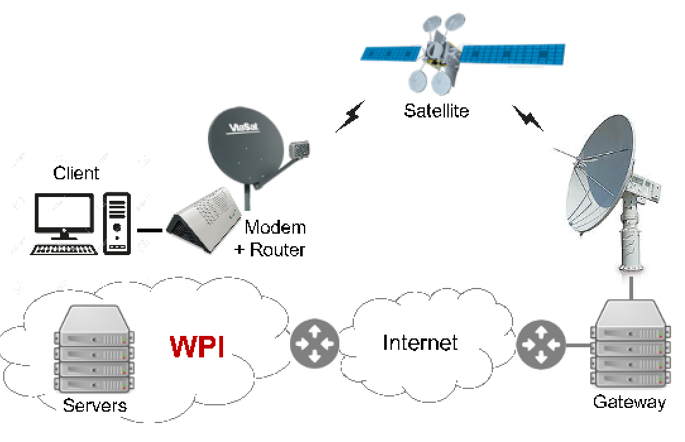
Methodology
ViaSat link to represent a client with a “last mile” satellite connection
Tests were run serially to minimize differences
1Gbyte bulk downloads
5 or 10 runs were averaged together
Measurements taken at the sender
BDP: 18 MB/s * 600 ms = 10.8 MB
144 Mb/s
Notes:
To run experiments, we set up a client connected to the ViaSat network to represent a user with a last mile satellite connection. We also set up servers at WPI that were connected through the internet to our client. We ran 5-10 experiments serially to minimize the impact of temporal differences in the network. Our VialSat plan allows for up to 144Mb/s with a 600ms round trip time making the bandwidth delay product of our link 10.8MB. All machines in our testbed are running Linux kernel version 4.15.0. The performance enhancing proxy that ViaSat deploys by default was disabled for all trials.

Slide 6
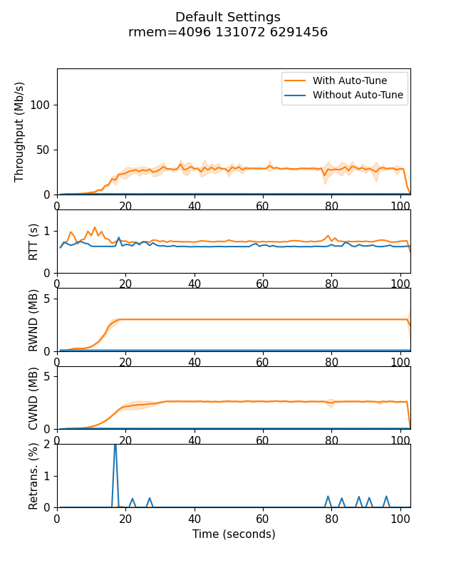
Default Settings
Linux Defaults
  HyStart enabled
  Auto-Tune enabled
  rmem = 4KiB, 128KiB, 6MiB
  wmem = 4KiB, 16KiB, 4MiB
Message: Utilization below link capacity

Slide 7
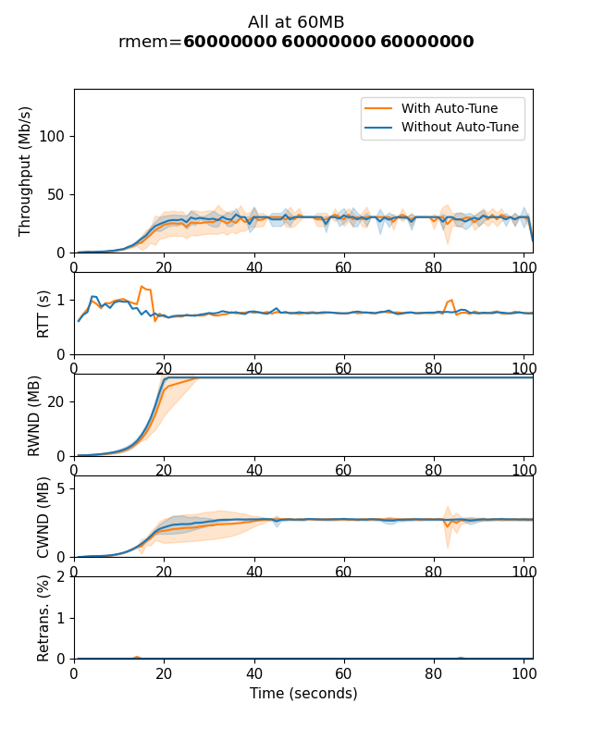
Increasing RMEM
VNKXK9W1KD
Run settings:
  HyStart enabled
  rmem = 60MB, 60MB, 60MB
  wmem = 4KiB, 16KiB, 4MiB
Messages:
Increasing receiver buffer means some improvement without auto-tune
Still well below expected throughput
Similar throughput is achieved with and without auto-tune

Slide 8
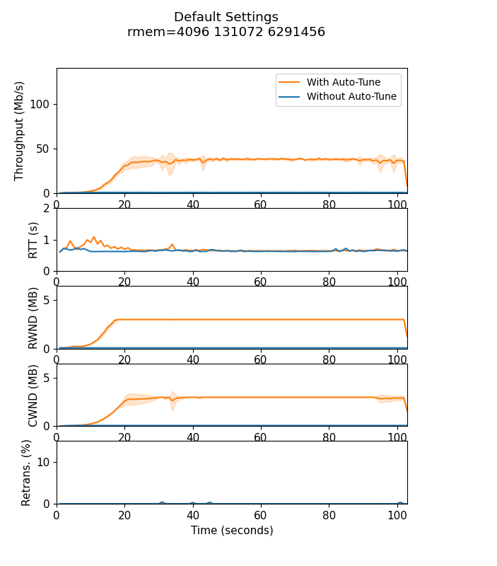
Increasing WMEM
VNKXK9W1KD
Run Settings:
  HyStart enabled
  rmem = 4KiB, 128KiB, 6MiB
  wmem = 60MB, 60MB, 60MB
Messages:
Increasing sender buffer improves performance for auto-tune streams
Throughput is still limited by receiver buffer sizes

Slide 9
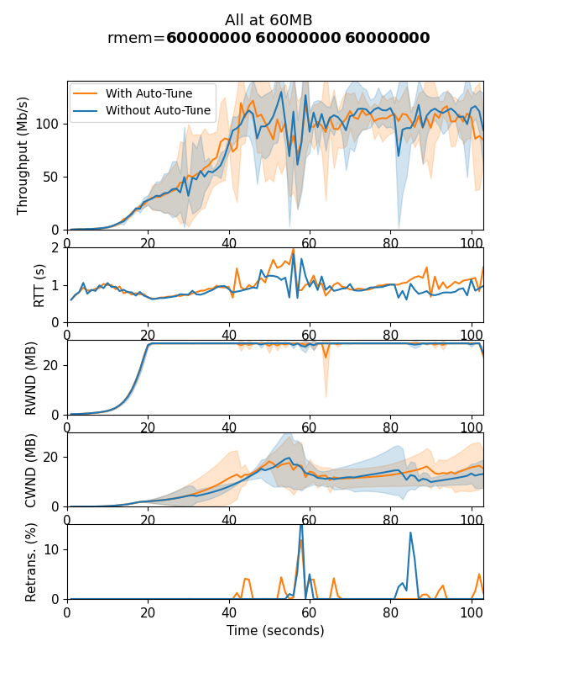
Increasing All Buffers
VNKXK9W1KD
Run Settings:
  HyStart enabled
  rmem = 60MB, 60MB, 60MB
  wmem = 60MB, 60MB, 60MB
Messages:
Increasing all buffers results in full utilization
Runs are visually similar with and without auto-tune

Slide 10
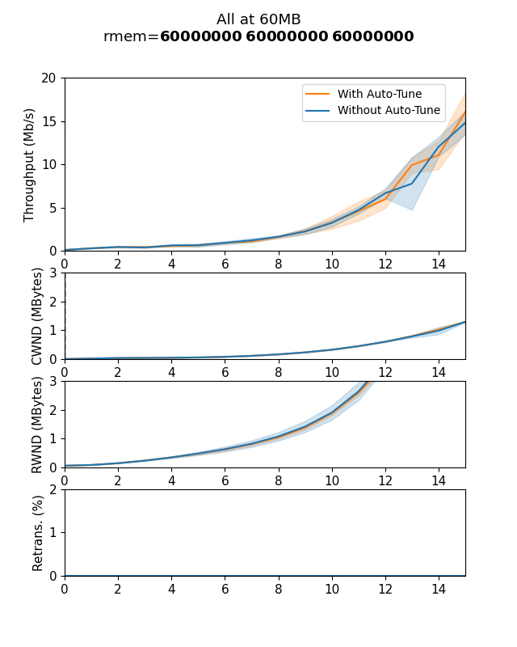
Startup Performance
VNKXK9W1KD
First 15 seconds of previous graph
Run Settings:
  HyStart enabled
  rmem = 60MB, 60MB, 60MB
  wmem = 60MB, 60MB, 60MB
Message: Visually no difference between runs with and without auto-tune

Slide 11
Buffer Setting Recommendations
Auto-tune (tcp_moderate_rcvbuf)
  Default: Enabled
  Recommended: Enabled
Receiver buffer (tcp_rmem)
  Default: 4096 131072 6291456
  Recommended: 4096 131072 26214400
Sender buffer (tcp_wmem)
  Default: 4096 16384 4194304
  Recommended:4096 16384 26214400
TCP only advertises up to half of the buffer size

Slide 12
Outline
Introduction (Done)
Background (Done)
Methodology (Done)
Buffer Settings Results (Done)
Hystart Results(Up Next)
Conclusion

Slide 13
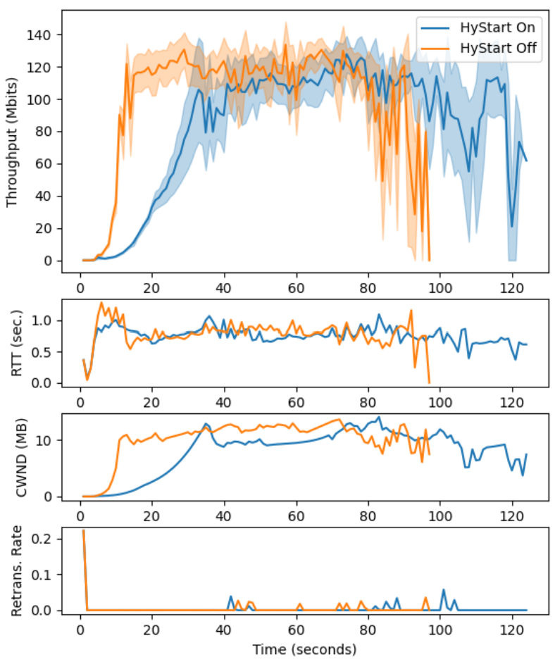
Comparing HyStart On/OFF
Run Settings:
  Auto-tune enabled
  rmem = 60MB, 60MB, 60MB
  wmem = 60MB, 60MB, 60MB
  1G download
Messages:
HyStart off reaches steady state about 20 seconds earlier than HyStart on
HyStart off finishes the download about 25 seconds faster than HyStart on

Slide 14
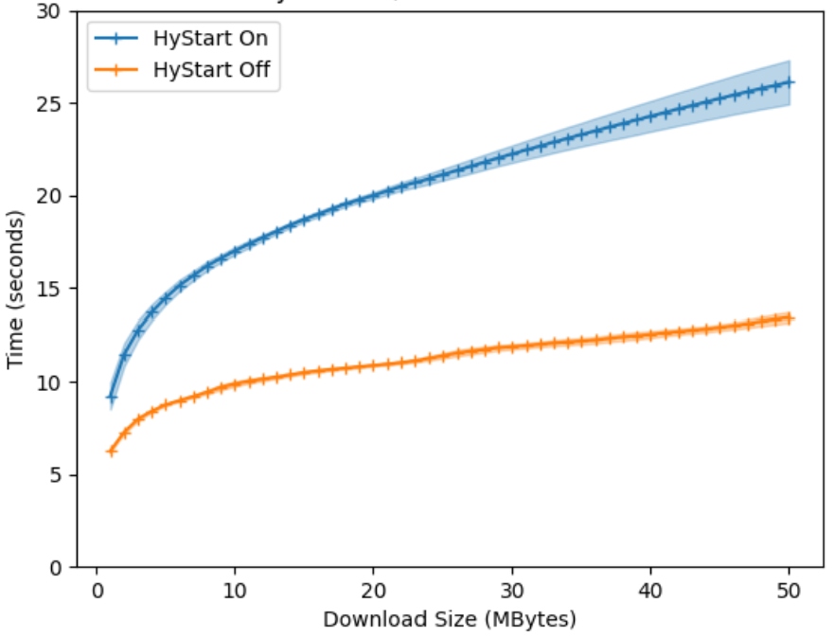
Download Times
Run Settings:
  rmem = 60MB, 60MB, 60MB
  wmem = 60MB, 60MB, 60MB
  Auto-tune enabled
1 MB downloads takes 50% longer with HyStart
The average website (5MB) takes 2x longer with HyStart on
Messages:
HyStart on makes small transfers take longer

Slide 15
Exiting HyStart
/* first detection parameter-ack-train detection */ if((s32)(now - ca->last_ack) <= hystart_ack_delta){
ca->last_ack = now;
if((s32)(now - ca->round_start) > ca->delay_min >> 4){
ca->found |= HYSTART_ACK_TRAIN;
}
}
#define HYSTART_MIN_SAMPLES 8
#define HYSTART_DELAY_MIN (4U<<3)
#define HYSTART_DELAY_MAX (16U<<3)
#define HYSTART_DELAY_THRESH(x) clamp(x, HYSTART_DELAY_MIN, HYSTART_DELAY_MAX)
if (ca->curr_rtt > ca->delay_min +
HYSTART_DELAY_THRESH(ca->delay_min >> 3)) {
ca->found |= HYSTART_DELAY;
}
HyStart looks for 2 signals to exit slow start
  ACK packet trains
  Increases in round-trip delay
Exiting slow start too early degrades performance

Slide 16
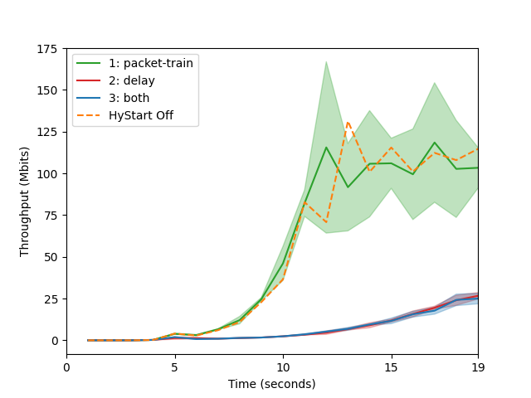
HyStart Exit Triggers
Packet-train only performs similarly to HyStart off
  Packet-train doesn’t cause HyStart to exit early
Delay only performs similarly to both
  Delay is the reason HyStart exits slow start early

Slide 17
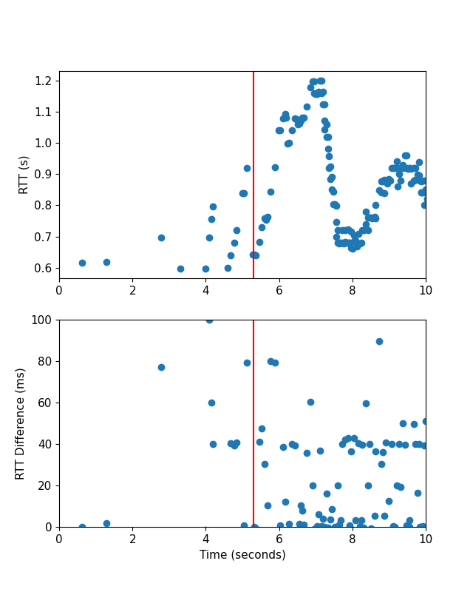
HyStart exit conditions
HyStart exits slow start after only 15-22 ACKs are received
HYSTART_MAX_DELAY is fixed at 16 ms (~3% of total RTT)
Delay changes regularly exceeded 16 ms causing HyStart to exit

Slide 18
HyStart Recommendations
HYSTART_DELAY_MAX should change based on network characteristics
  Tracking average and standard deviation statistics about RTT should be sufficient
  Testing is needed to determine an appropriate value
#define HYSTART_DELAY_THRESH(x) clamp(x, HYSTART_DELAY_MIN, UINT32_MAX)
ca->delay_min_avg = ca->delay_min_avg * (1 - EWA) + ca->delay_min * EWA
HYSTART_DELAY_THRESH(ca->delay_min_avg >> 3)

Slide 19
Conclusion
Satellites are used everywhere, and PEPs are becoming increasingly ineffective
Linux default buffer sizes are too small degrading performance over high BDP networks
Buffer auto-tuning is effective and does not limit exponential growth during slow start
HyStart can exit slow start prematurely on connections with more variable round-trip times

Slide 20
Future work
Improving HyStart RTT based exit
HyStart++
Other TCP settings
  Initial congestion window
  Fast convergence
  The β parameter for window factor decrease
  HyStart RTT₀
Competing flows over a satellite Internet link
  BBR
  Hybla
  QUIC

Slide 21
Thank You!
Benjamin Peters, Pinhan Zhao, Jae Chung, Mark Claypool

